Slide 1

Wear’s the Party!
Paul Lammertsma
CTO, Pixplicity

Slide 2
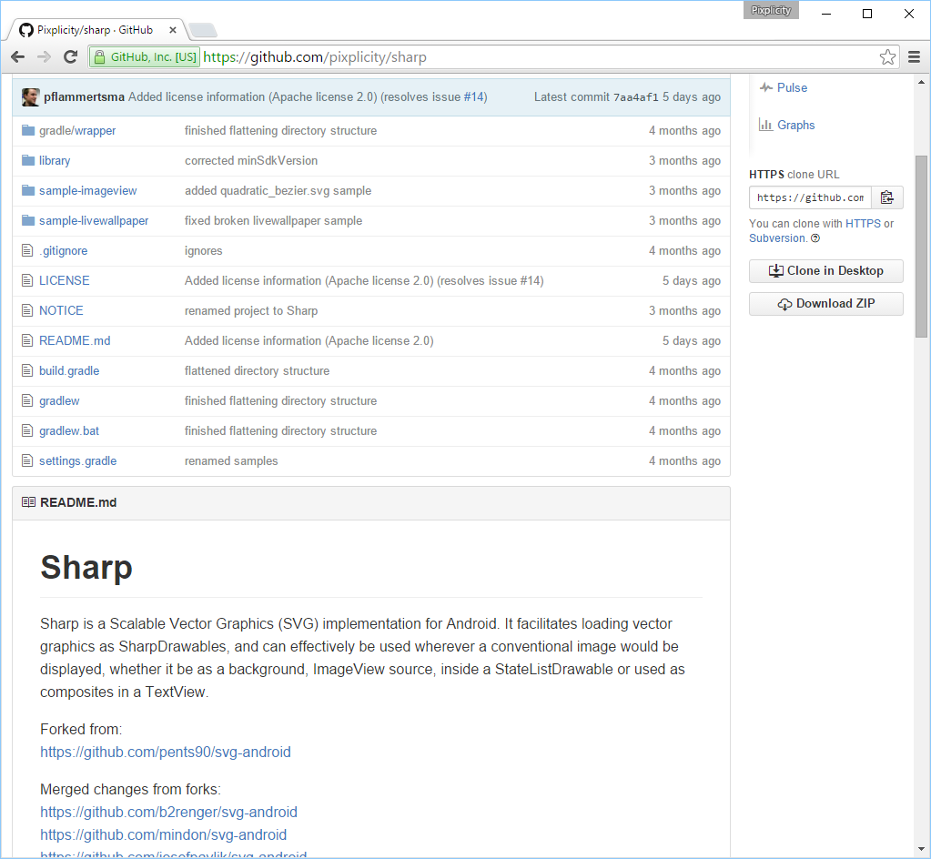
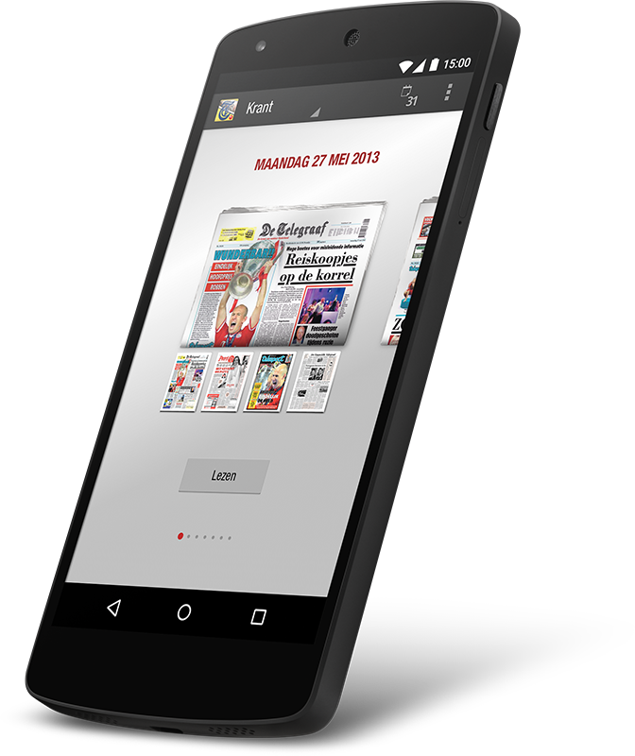
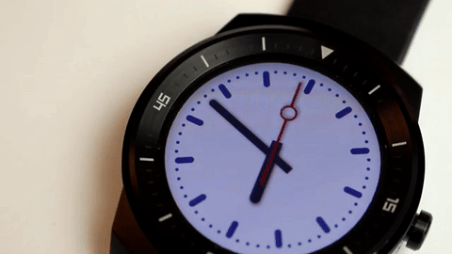
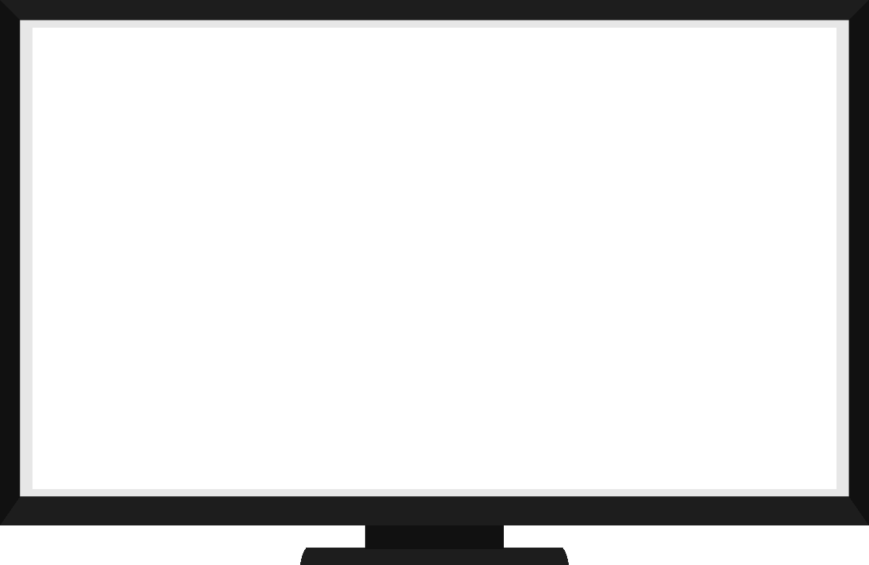


www.pixplicity.com

Slide 3
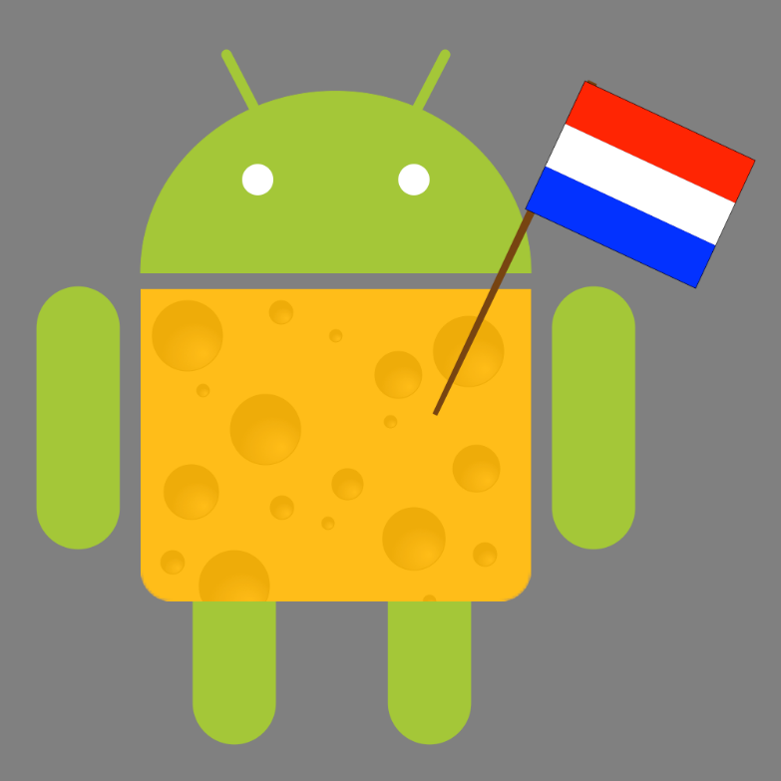
www.dutchaug.org

Slide 4
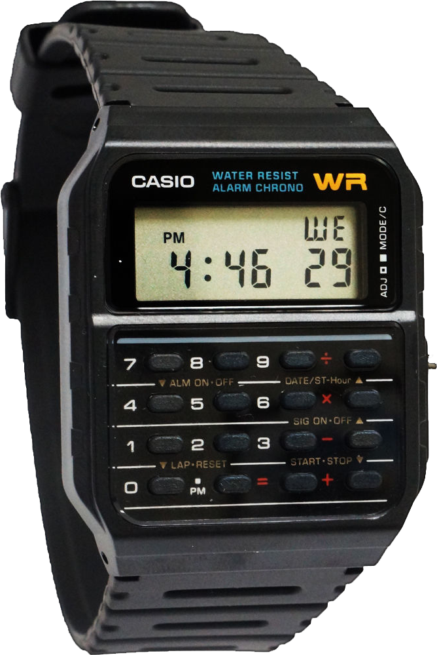

Slide 5
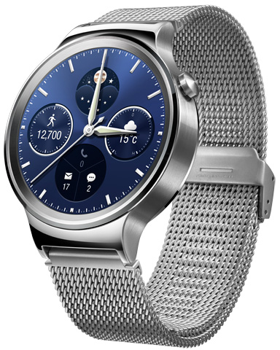
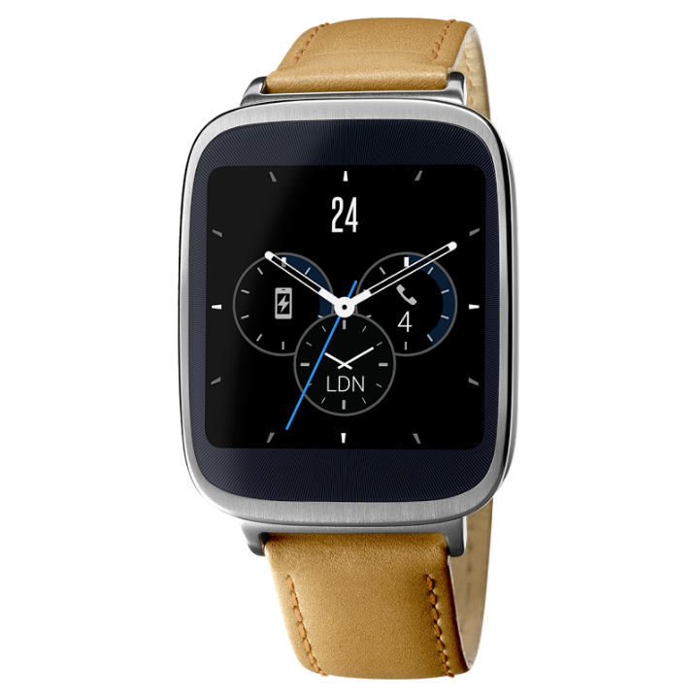
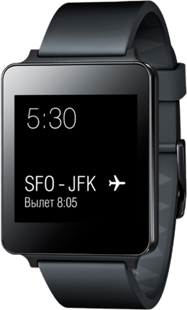
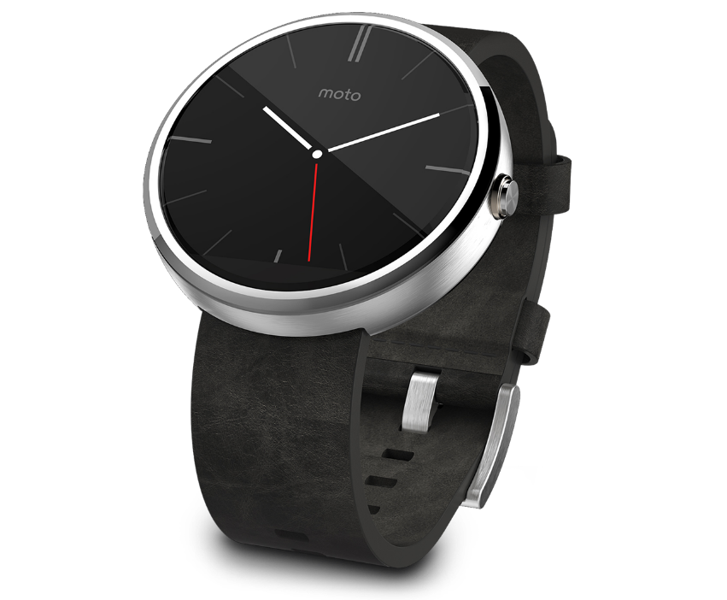
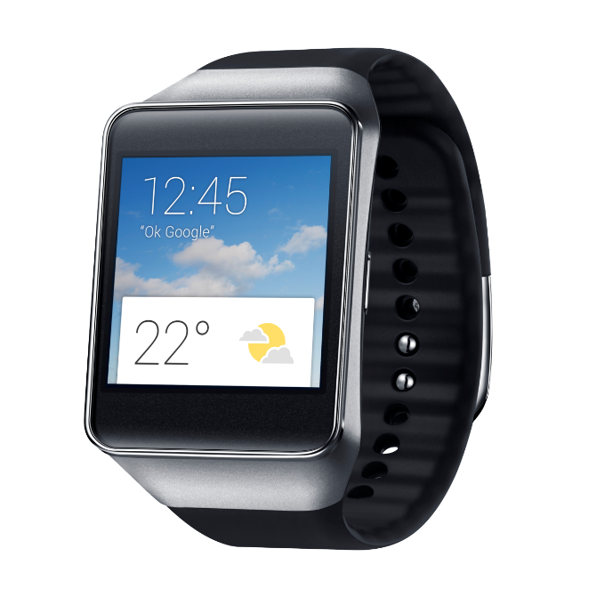
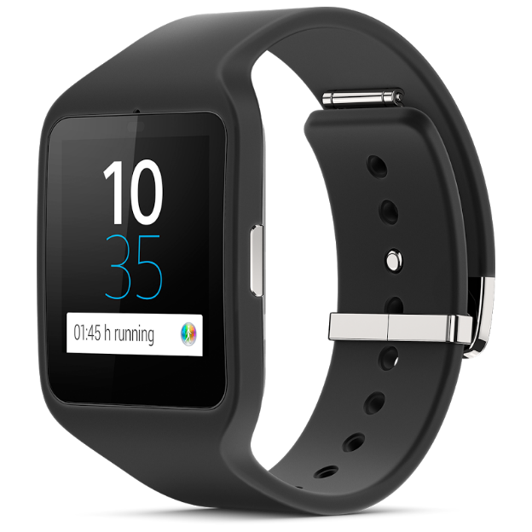
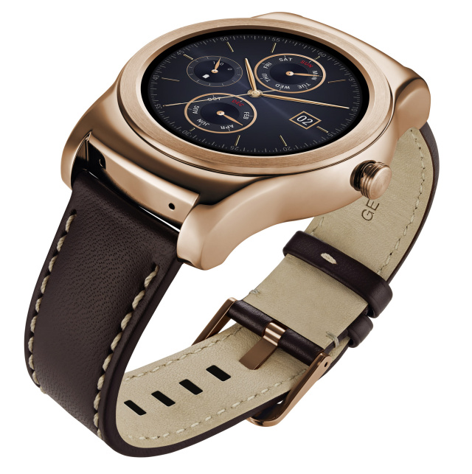
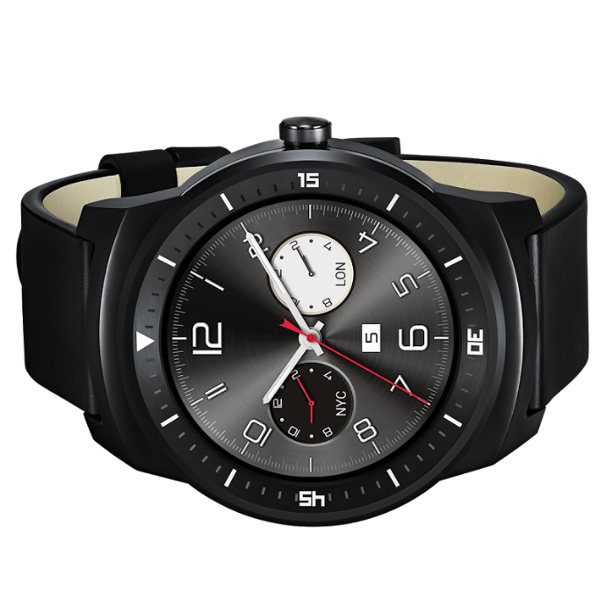
Notes:
The party started in March 2014.
Left to right: Sony Smartwatch 3, Samsung Gear Live, Asus Zenwatch, LG G Watch, LG Watch Urbane, Motorola Moto 360, (front) LG G Watch R

Slide 6
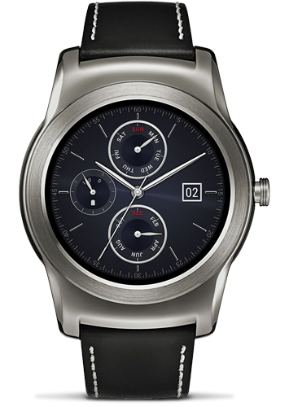
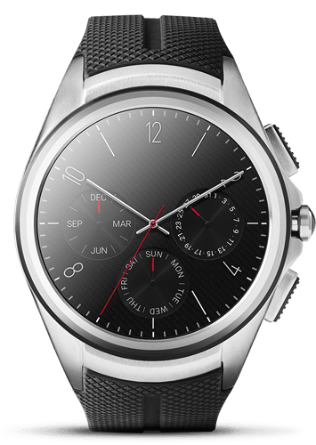
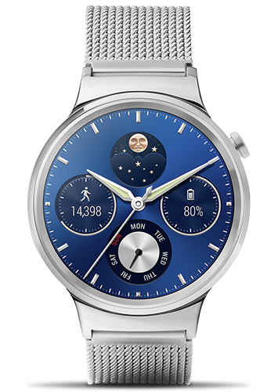
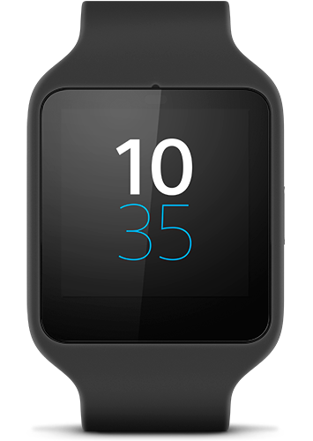
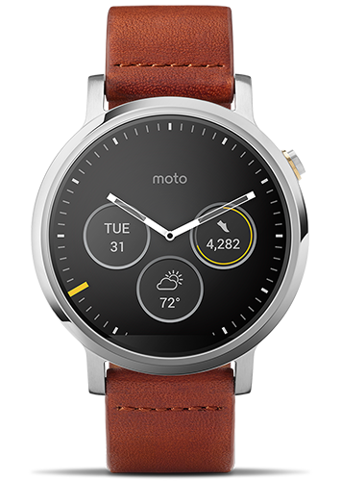
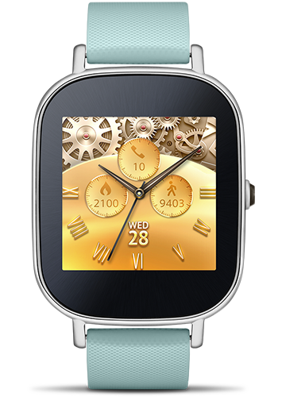
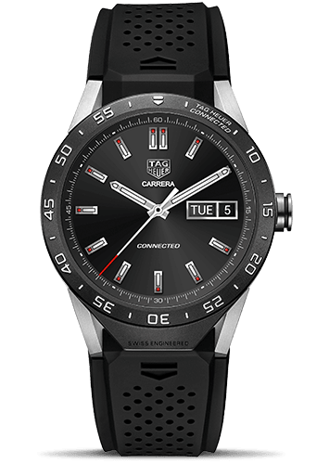
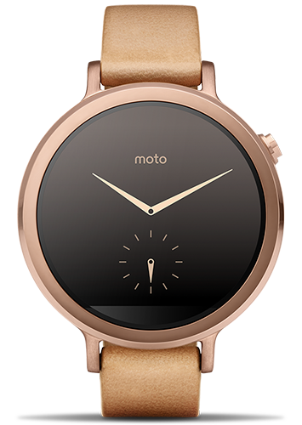
Notes:
Currently available for sale, Left to right: Top: LG Watch Urbane, LG Watch Urbane 2nd edition LTE, Huawei Watch, Sony SmartWatch 3
Bottom: Motorola Moto 360 2015 42mm (also 46mm), Motorola Moto 360 for Women 2015, ASUS ZenWatch 2, TAG Heuer Connected

Slide 7
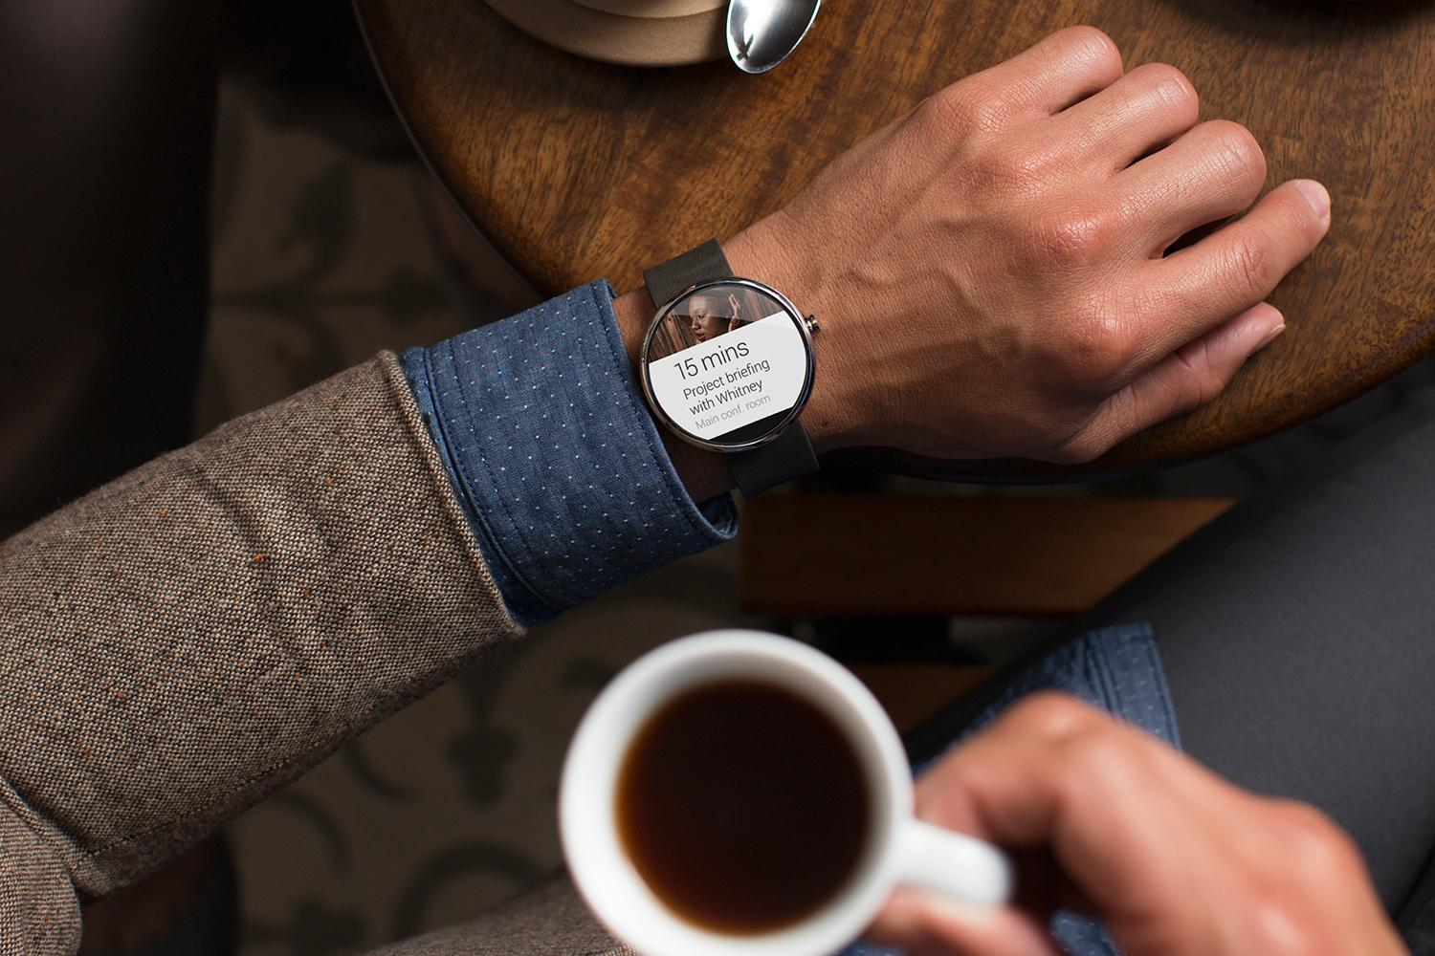
Short demo

Slide 8
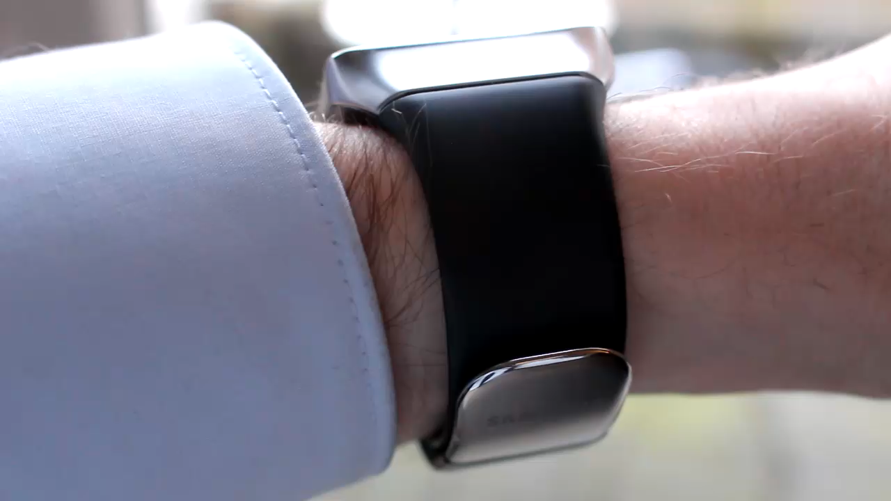

Slide 9
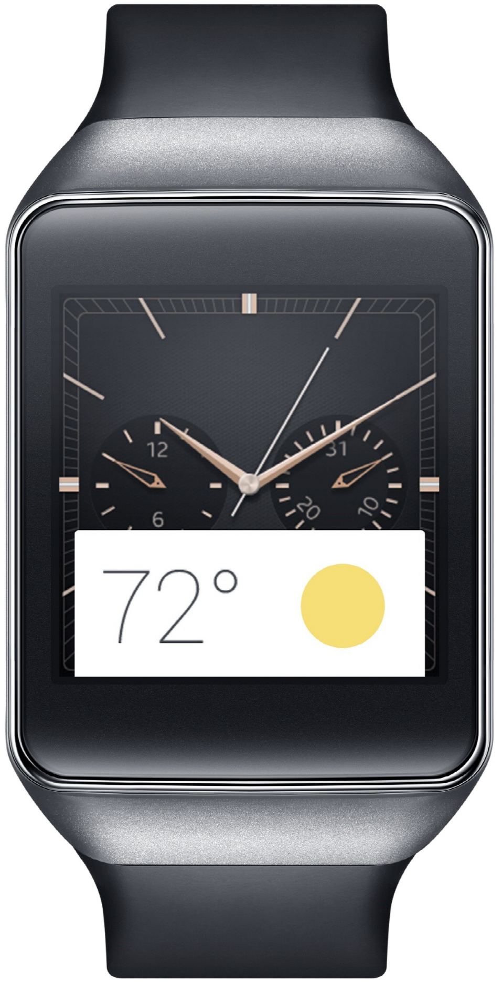
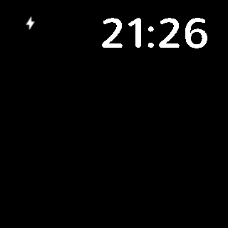

Slide 10
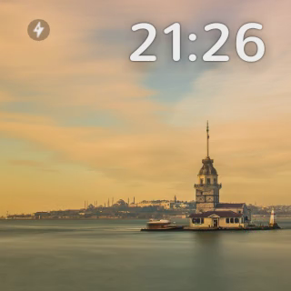

Slide 11
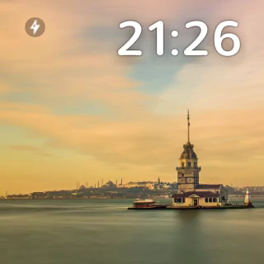

Slide 13
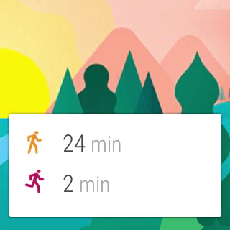

Slide 14
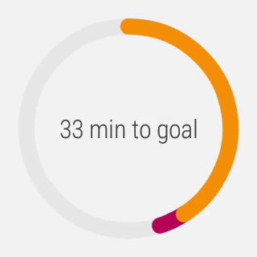

Slide 15
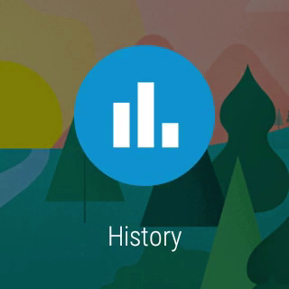

Slide 16
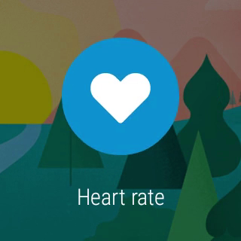

Slide 17
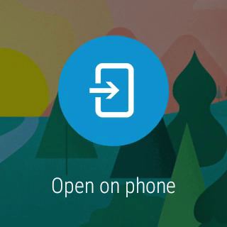

Slide 18
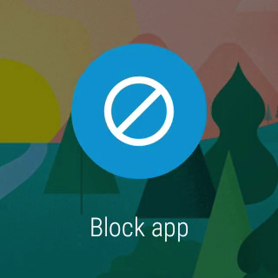

Slide 19
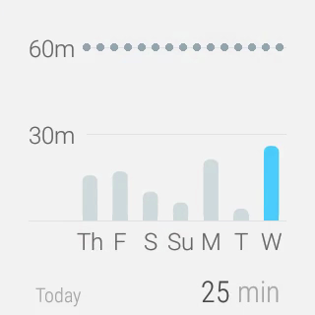

Slide 20
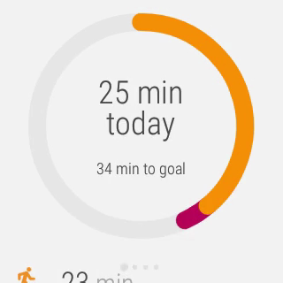

Slide 22

Creative vision

Slide 23
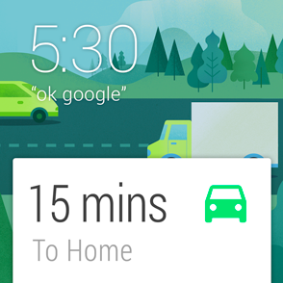
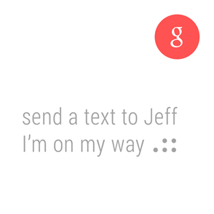
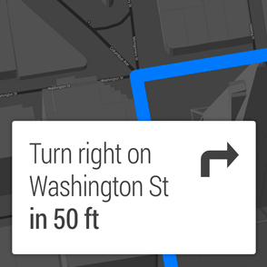
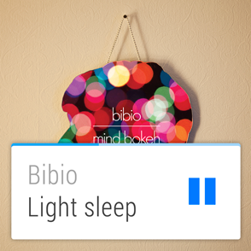
Launched automatically
Suggest and demand
Zero or low interaction
Glanceable
Notes:
“Android Wear is timely, relevant and very specific.”

Slide 24
Launched automatically
Cards appear on the stream when they become relevant
Timely
Relevant
Very specific
Notes:
“Android Wear is timely, relevant and very specific.”

Slide 25
Glanceable
See information in a split second
Fast
Sharp
Immediate
Notes:
“Android Wear is fast, sharp, and immediate.”

Slide 26
Suggest and demand
Only interrupts you when necessary Always on hand to provide an answer
Helpful
Respectful
Responsive
Notes:
“Android Wear is helpful, respectful, and responsive.”

Slide 27
Zero or low interaction
Input rarely needed Avoids fine-grained finger movements
Gestural
Simple
Fast
Notes:
“Android Wear is gestural, simple, and fast.”

Slide 28

Under the hood

Slide 29
It’s Android
Android-powered wearable on your wrist
Running 5.0 Lollipop
Unified experience between different manufacturers
Specially designed apps for Wear
…but you don’t need to go hunting for them

Slide 30
It’s not a replacement
Connected to phone or tablet
Requires Android 4.3+
Portal to the internet
Mirrors notifications
Apps with Wear features magically work

Slide 31
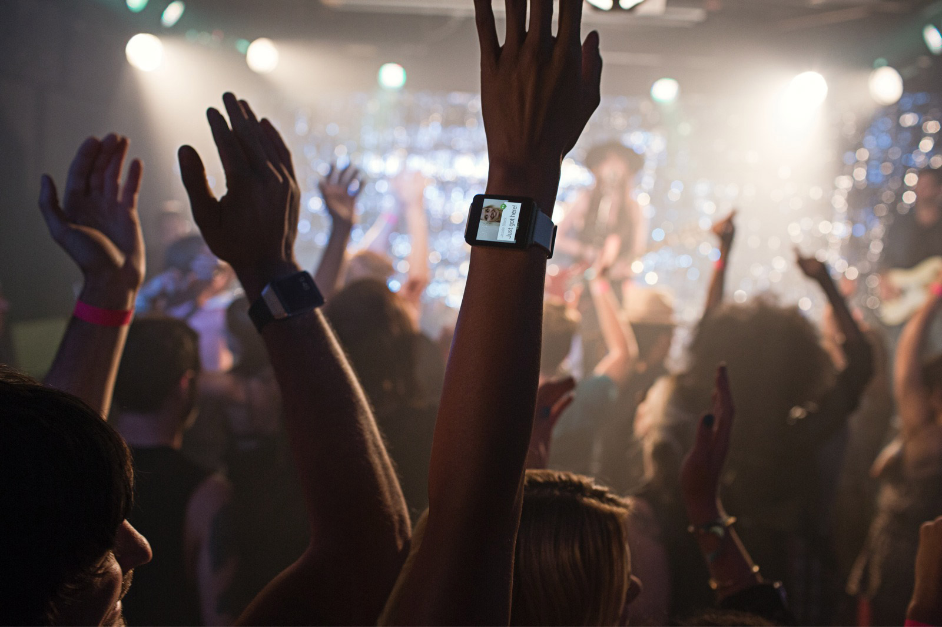
Watchfaces Notifications Wear apps

Slide 32
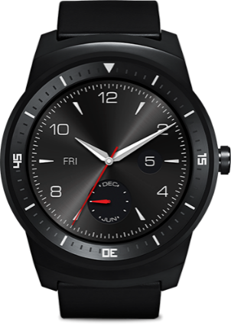
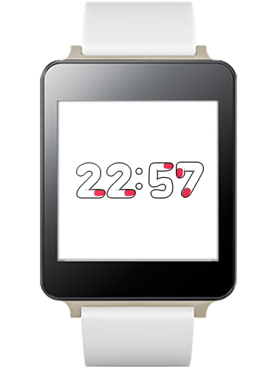
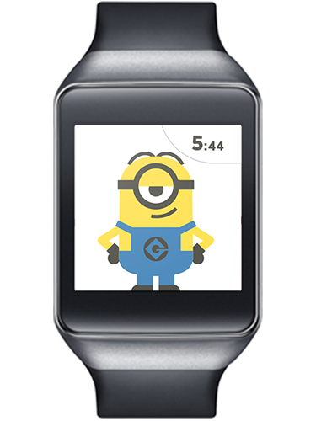
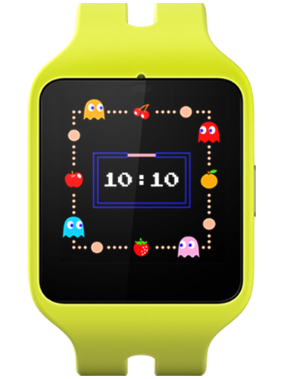
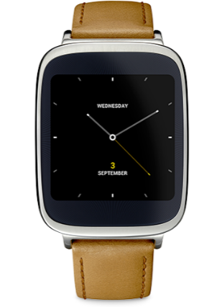
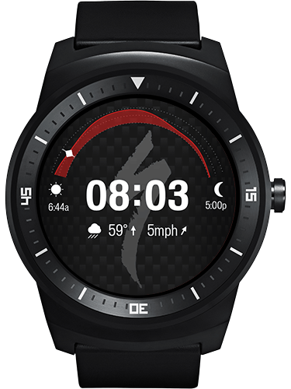
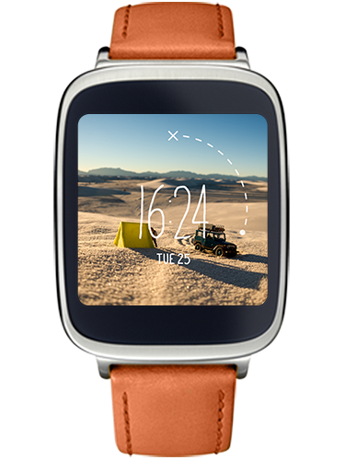
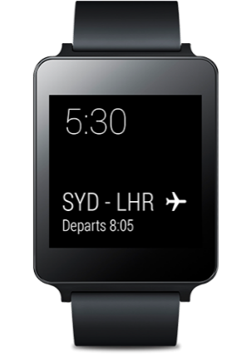
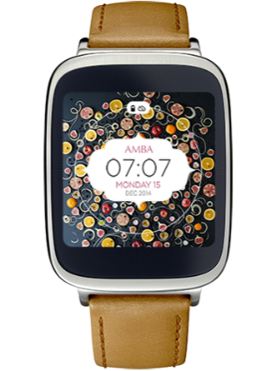







Watchfaces
Notes:
Custom watchfaces.

Slide 33
Watchfaces
Watchface API introduced in Lollipop
Draws on a OpenGL-backed canvas inside a Service

Slide 34
Watchfaces
public class AnalogWatchFaceService extends CanvasWatchFaceService {
@Override public AnalogEngine onCreateEngine() { // Provide your watch face implementation return new AnalogEngine(); } ... }

Slide 35
Watchfaces
CanvasWatchFaceService.Engine provides callbacks for
Initializing your watch face
Obtaining device properties (e.g. burn-in screen, low-bit ambient mode)
Time changes
Entering and exiting ambient mode
Draw passes
Visibility changes

Slide 36
Watchfaces
private class AnalogEngine extends CanvasWatchFaceService.Engine { ... @Override public void onDraw(Canvas canvas, Rect bounds) { // Draw your watch face } ... }

Slide 37









Notifications

Slide 38


Notifications
NotificationCompat works “out of the box”
}
}
}
Title, description and icon
Actions
Reserved actions

Slide 39
Notifications
Pages
DisplayIntents (requires Wear app)
Notes:
Pages: supplementary information / detail card. For instance weather
DisplayIntents: completely custom tailored views

Slide 40
Notifications
with NotificationCompat
NotificationCompat.Builder notificationBuilder = new NotificationCompat.Builder(this); notificationBuilder .setSmallIcon(R.drawable.ic_event) .setContentTitle(eventTitle) .setContentText(eventLocation) .setContentIntent(viewPendingIntent);

Slide 41
Notifications
with NotificationCompat
// Get an instance of the NotificationManager service NotificationManagerCompat notificationManager = NotificationManagerCompat.from(this); // Build the notification and issue it with the manager notificationManager.notify( notificationId, notificationBuilder.build());

Slide 42


Notifications
with NotificationCompat

Slide 43
Notifications
with NotificationCompat
NotificationCompat.Action action = new NotificationCompat.Action.Builder( R.drawable.ic_map, getString(R.string.map),
mapPendingIntent).build() // Add the action button notificationBuilder .addAction(action);

Slide 44

Notifications
with NotificationCompat

Slide 45
Enriching notifications
just for wearables
// Add functionality for wearables WearableExtender wearableExtender = new NotificationCompat.WearableExtender() // Add an action button, but only on wear wearableExtender.addAction(action); notificationBuilder .extend(wearableExtender);

Slide 46
Enriching notifications
just for wearables
final Bitmap background = BitmapFactory.decodeResource( context.getResources(), R.drawable.im_backdrop); // Add a pretty background wearableExtender.setBackground(background);

Slide 47


Enriching notifications
just for wearables

Slide 48
Enriching notifications
Voice reply
Add RemoteInput to Reply action
action.addRemoteInput( new RemoteInput.Builder(EXTRA_REPLY_TEXT) .setLabel(getString(R.string.replyLabel)) .setChoices(…) .build();

Slide 49
Enriching notifications
Voice reply
Modify handheld app to use reply text
Bundle results = RemoteInput.getResultsFromIntent(intent); if (results != null) { String message = results.getString(EXTRA_REPLY_TEXT); }

Slide 50



Enriching notifications
Voice reply

Slide 51
Enriching notifications
Pages
More information without requiring app on handheld
For instance:
Contents of an email
Calendar events
Chat history

Slide 52
Enriching notifications
Pages
Notification chatHistory = new NotificationCompat.Builder(context)
.setStyle(new NotificationCompat.BigTextStyle() .bigText(getChatHistory())) .build(); wearableExtender.addPage(chatHistory);

Slide 53


Enriching notifications
Pages

Slide 54

Wear apps

Slide 55

Wear apps

Slide 56


Wear apps

Slide 57

Wear apps

Slide 58

Wear apps
Installed on the wearable
For development:
Use Wear emulators, or
Launch on a physical watch through USB or BLE
In release, bundled in the mobile’s APK
Inside res/raw

Slide 59
Wear apps
Gradle
Included in the mobile module’s build.gradle: wearApp project(':wear')
Manifest
Included in the wear module’s manifest: <uses-feature android:name="android.hardware.type.watch" />

Slide 60
Wear apps
Communicating with a companion app on host device
Wearable Data Layer API (Google Play Services)
An Android Training is available
Libraries such as BusWear, an event bus for Android Wear

Slide 61






Wear apps

Slide 62

Enriching notifications
DisplayIntents

Slide 63
Enriching notifications
DisplayIntents
Wear app must create the notification itself
DisplayIntent references an Activity and draws it
Different sizes: XSMALL, SMALL, MEDIUM, LARGE, FULL_SCREEN

Slide 64
Enriching notifications
DisplayIntents
wearableExtender .setCustomSizePreset( Notification.WearableExtender.SIZE_FULL_SCREEN) .setDisplayIntent( PendingIntent.getActivity( context, 0, new Intent( context, FullscreenActivity.class), 0));

Slide 65
Enriching notifications
DisplayIntents
<activity android:name="com.example.MyDisplayActivity" android:exported="true" android:allowEmbedded="true" android:taskAffinity="" android:theme="…" />

Slide 66


Tiny computers.

Slide 67

Awesome tiny computers.

Slide 68

Debugging
Attach the watch via USB
Enable ADB debugging on the wearable
Approve your machine’s RSA signature in the pop-up

Slide 69
Debugging
Attach the watch via USB
Enable debugging on the wearable:
Tap the home screen twice to bring up the Wear menu.
Scroll to the bottom and tap Settings.
Scroll to the bottom and tap the Developer Options. If there's no Developer Options item, tap About, and then tap the build number 7 times.
Enable ADB debugging.

Slide 70

Debugging
Approve your computer’s RSA signature in the pop-up on your phone

Slide 71
Debugging over Bluetooth
Enable Bluetooth debugging on the wearable
Attach the handheld via USB
Run: adb forward tcp:4444 localabstract:/adb-hub adb connect localhost:4444
Approve your machine’s RSA signature in the pop-up

Slide 72
Debugging over Bluetooth
Enable Bluetooth debugging on the wearable:
Tap the home screen twice to bring up the Wear menu.
Scroll to the bottom and tap Settings.
Scroll to the bottom and tap the Developer Options. If there's no Developer Options item, tap About, and then tap the build number 7 times.
Enable Debug over Bluetooth.

Slide 73
Debugging over Bluetooth
Connect the handheld to your machine over USB
Run: adb forward tcp:4444 localabstract:/adb-hub adb connect localhost:4444
Approve your computer’s RSA signature in the pop-up on your phone

Slide 74

Tips
Use a common project to share constants between your wear and handheld projects
Take special considerations for round devices
…and almost round devices

Slide 75
Gotchas!
Properly packaging a wearable app
Declare the wearable app module in the handheld app: wearApp project(':wearable')
The handheld and wearable apps have the same
Package name
Version number
All permissions declared in the wearable app must also be declared in the handheld app
Sign both apps and assemble the release variant

Slide 76
Gotchas!
Turn off asset compression
The wearable app is located in res/raw
It’s already compressed
Any other installation problems
Look at the PackageUpdateService tag in Logcat

Slide 77


Added value

Slide 78
Useful stuff
Android Training “Building Apps for Wearables” http://developer.android.com/training/building-wearables.html
Design Guide “Watch Faces for Android Wear” https://developer.android.com/design/wear/watchfaces.html
Android Developers YouTube channel https://www.youtube.com/user/androiddevelopers

Slide 79

Useful stuff
Pixplicity’s YouTube channel https://www.youtube.com/pixplicity

Slide 80

Wear’s the Party!
Source code & slides: http://github.com/Pixplicity/weardemo
Paul Lammertsma
CTO, Pixplicity

